Slide 1
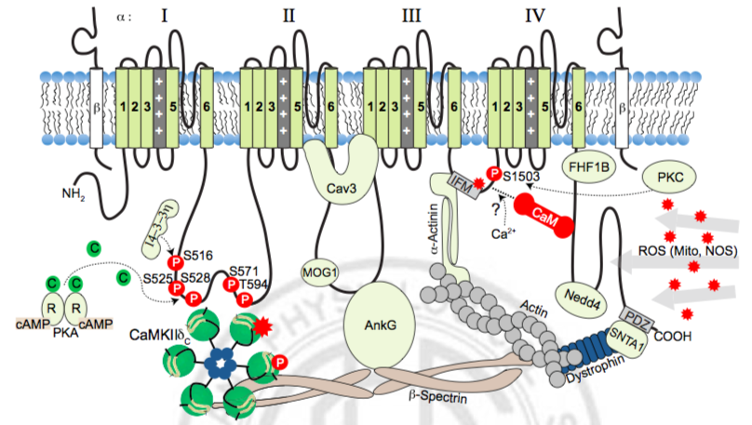
Pro-arrhythmic effects of Na⁺ channel blockers
Students: Kevin, Alan
ADVISORS: Glenn, Andy
Rellos et al. 2010

Slide 2
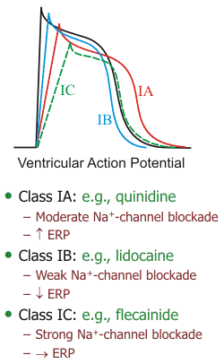
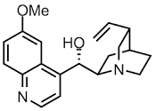
Class 1 antiarrhythmic agents
Class 1A: Quinidine
Fast binding kinetics
Modest off-target effects

Slide 3
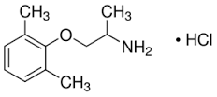
Class 1 antiarrhythmic agents
Class 1B: Mexiletine
Medium binding kinetics
Common off-target effects (particularly K⁺ channels)

Slide 4
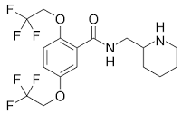
Class 1 antiarrhythmic agents
Class 1C: Flecainide
Slow binding kinetics
Medium off-target effects

Slide 5

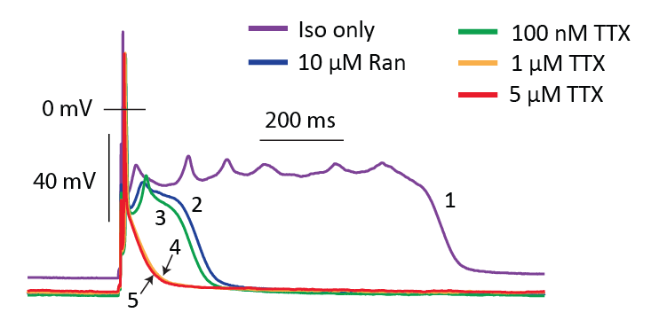
Pharmacological basis for discriminating I_{Na} behaviours
Model
Experiment

Slide 6
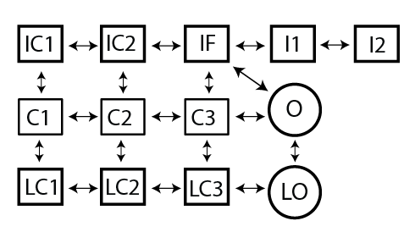
I_{Na} is recruited via non-equilibrium reactivation
Lidocaine
TTX

Slide 7
Non-equilibrium reactivation can be blocked by lidocaine
Lidocaine

Slide 8
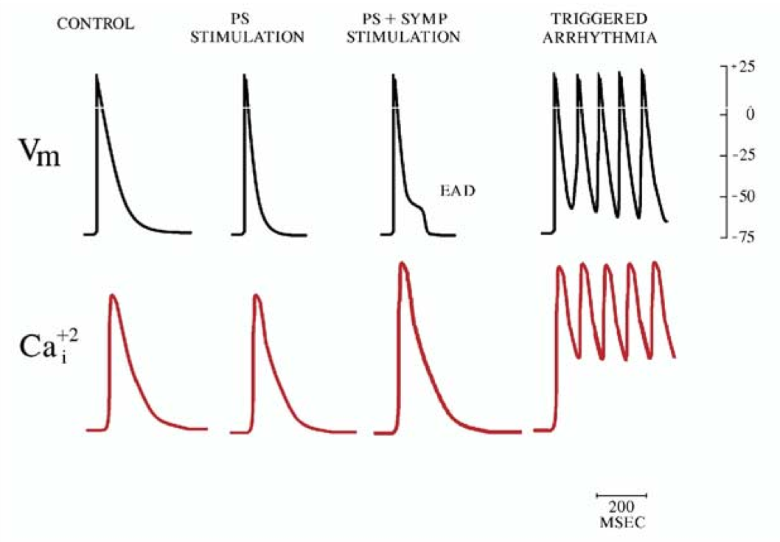
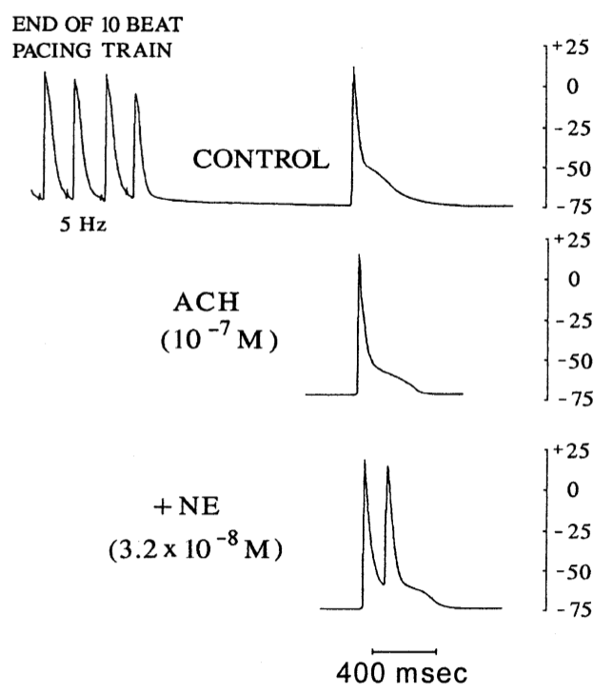
EADs initiate AF in canine atria (pulmonary veins)
Patterson et al. Heart Rhythm. 2005.
Patterson et al. JACC. 2006.

Slide 9
EADs carried by non-equilibrium I_{Na} in a human atrial cell model

Slide 10

Specific Objectives
Overall objective - develop models for the effects of Na⁺ channel block by:
Ranolazine
Lidocaine
Tetrodotoxin/Flecainide
Intermediary objectives:
Define appropriate experimental data for construction and parameterization
Validate parameterized model in terms of AP function
Test effects of model on EAD inducibility in mouse and human atrial models
Test model effects in simple 3D tissue constructs to refer to clinically measurable constructs (conduction velocity and ERP)

